Slide 1
Functions
WEEK – 6
TUTORIAL
4CS001 - Introductory Programming and Problem Solving
Basanta Singh

Slide 2
Function
Function is one of the means to achieve modularity and reusability.
Function can be defined as a named group instructions that accomplish a specific task when it is invoked.
It is defined using the def keyword, followed by the name of the function, set of parentheses that may include parameter.
The code block within every function starts with a colon (:) and is indented.
4CS001 - Introductory Programming and Problem Solving

Slide 3
The Advantages of Function
Increases readability, particularly for longer code as by using functions, the program is better organised and easy to understand.
Reduces code length as same code is not required to be written at multiple places in a program. This also makes debugging easier.
Increases reusability, as function can be called from another function or another program. Thus, we can reuse or build upon already defined functions and avoid repetitions of writing the same piece of code.
Work can be easily divided among team members and completed in parallel.
4CS001 - Introductory Programming and Problem Solving

Slide 4
Function Types
There are two types of function in python:
Standard Library Function: These are built-in function which we have using since our first day at class. Some of the built in function that have used are len(), range(), format(), input(), int() and so on.
User – defined Functions: We can create our own functions based on our requirement.
4CS001 - Introductory Programming and Problem Solving

Slide 5
Built-in Functions
Common Built in Function
Mathematical Function
abs() divmod() max() min() pow() sum()
Input or Output
input () print()
Data Type Conversion
bool() chr() dict() float() int() list() ord() set() str() tuple()
Other Functions
__import__() len() range() type()
4CS001 - Introductory Programming and Problem Solving

Slide 6
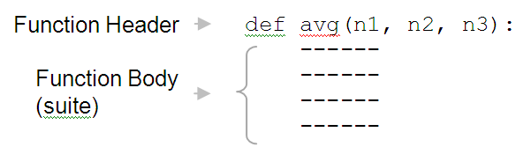
User Defined Functions
A function header starts with the keyword def, followed by an identifier (e.g. avg), which is the function’s name. The function name is followed by a comma-separated (possibly empty) list of identifiers (n1, n2, n3) called parameters. Following the parameter list is a colon ( : )
Following the function header is the function body, a suite (program block) containing the function’s instructions. The statements within the suite must be indented at the same level, relative to the function header.
4CS001 - Introductory Programming and Problem Solving

Slide 7
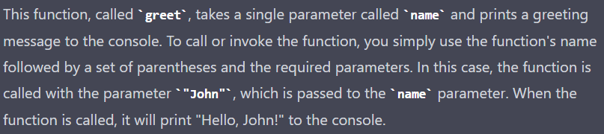
User Defined Functions
def greet(name):
# This function prints a greeting to the specified name
print("Hello, " + name + "!")
# Calling the function….below…
greet("John")
4CS001 - Introductory Programming and Problem Solving

Slide 8
Exercise – For You
Write a user defined function to add 2 numbers and display their sum.
Function to add two numbers
The requirements are listed below:
We need to accept 2 numbers from the user.
Calculate their sum.
Display the sum.
4CS001 - Introductory Programming and Problem Solving

Slide 9
Code Implementation
def addnum():
fnum = int(input("Enter first number: "))
snum = int(input("Enter second number: "))
sum = fnum + snum
print("The sum of", fnum, "and", snum, "is", sum)
# Function call
addnum()
4CS001 - Introductory Programming and Problem Solving

Slide 10
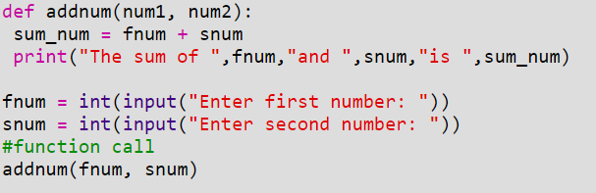
Arguments and Parameters
In the above example, the numbers were accepted from the user within the function itself, but it is also possible for a user defined function to receive values at the time of being called. An argument is a value passed to the function during the function call which is received in corresponding parameter defined in function header.
4CS001 - Introductory Programming and Problem Solving

Slide 11
Parameter Passing
Parameter passing is the process of passing arguments to a function.
Recall that actual arguments are the values passed to a function’s formal parameters.
The correspondence of actual arguments and formal parameters is determined by the order of the arguments passed, and not their names.
Parameters could be passed to a function in three different ways
Positional Arguments
Keywords Arguments
Default Argument
4CS001 - Introductory Programming and Problem Solving

Slide 12
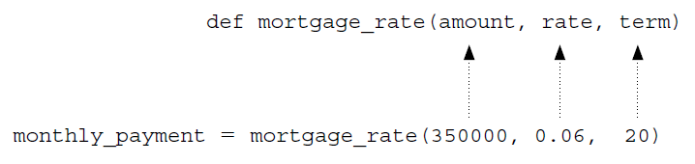
Positional Arguments in Python
The functions we have looked at so far were called with a fixed number of positional arguments.
A positional argument is an argument that is assigned to a particular parameter based on its position in the argument list,
4CS001 - Introductory Programming and Problem Solving

Slide 13
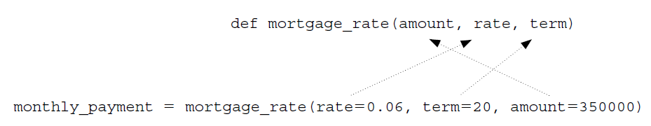
Keyword Arguments in Python
Python provides the option of calling any function by the use of keyword arguments. A keyword argument is an argument that is specified by name, rather than as a positional argument.
This can be a useful way of calling a function if it is easier to remember the parameter names than it is to remember their order.
4CS001 - Introductory Programming and Problem Solving

Slide 14
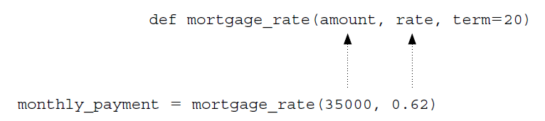
Default Arguments in Python
Python provides for default arguments. A default argument is an argument that can be optionally provided.
Parameter term is assigned a default value, 20, and therefore is optionally provided when calling function mortgage_rate.
All positional arguments must come before any default arguments in a function definition.
4CS001 - Introductory Programming and Problem Solving

Slide 15
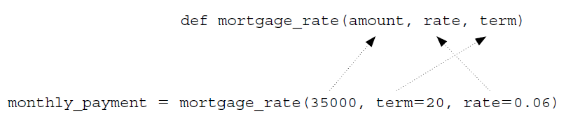
Keyword Arguments in Python
It is possible to call a function using both positional and keyword arguments. However, all positional arguments must come before all keyword arguments in the function call
This form of function call might be useful, for example, if you remember that the first argument is the loan amount, but you are not sure of the order of the last two arguments rate and term.
4CS001 - Introductory Programming and Problem Solving

Slide 16
Value Returning Functions
A value-returning function is a program routine called for its return value, and is therefore similar to a mathematical function, e.g.,
f(x) = 2x
In this notation, “x” stands for any numeric value that function f may be applied to,
f(2) = 2 x 2 = 4
Program functions are similarly used.
4CS001 - Introductory Programming and Problem Solving

Slide 17
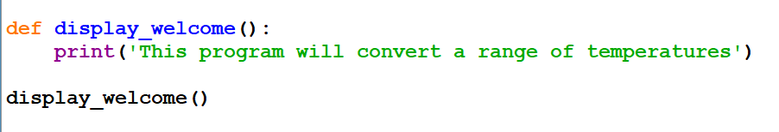
Non-Value Returning Functions
A non-value-returning function is called not for a returned value, but for its side effects. A side effect is an action other than returning a function value, such as displaying output.
4CS001 - Introductory Programming and Problem Solving

Slide 18
Function Calls Overview
A call to a value-returning function is an expression. It evaluates to the value returned by the function call. Thus, calls to value-returning functions are made part of a larger expression:
result = avg(10, 25, 16) * factor
A call to a non-value-returning function is a statement. Thus, calls to non-value-returning functions are written as a statement (instruction) on its own: displayWelcome()
Technically, all functions in Python are value-returning, since functions that do not return a value return special value None.
4CS001 - Introductory Programming and Problem Solving

Slide 19
Points to Ponder
So far we have learnt that function may or may not have parameter(s) and a function may or may not return any value(s). In Python, as per our requirements, we can have the function in either of the following ways:
Function with no argument and no return value
Function with no argument but return value
Function with argument(s) but no return value
Function with argument(s) and return value(s)
4CS001 - Introductory Programming and Problem Solving

Slide 20
Variable Scope
Variable scope has to do with the parts a program that a given variable is accessible.
A local variable is a variable that is only accessible from within a given function. Such variables are said to have local scope. In Python, any variable assigned a value in a function becomes a local variable of the function.
What does this mean then?
Local variables are only accessible inside the functions they are defined within.
4CS001 - Introductory Programming and Problem Solving

Slide 21
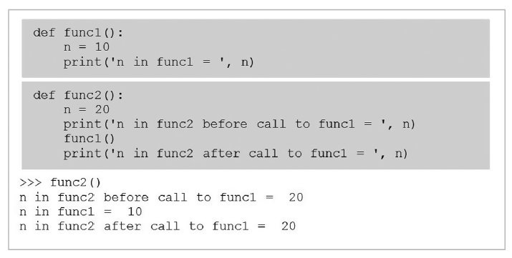
Both func1 and func2 contain identifier n. Function func1 assigns n to 10, while function func2 assigns n to 20. Both functions display the value of n when called—func2 displays the value of n both before and after its call to func1. If identifier n represents the same variable, then shouldn’t its value change to 10 after the call to func1?
The execution of func2, however, shows that the value of n remains unchanged.
4CS001 - Introductory Programming and Problem Solving

Slide 22
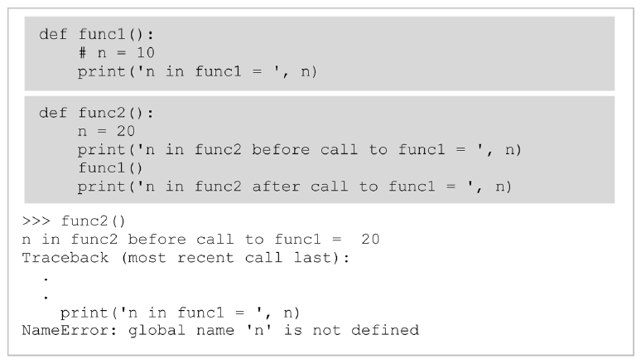
Now consider the following:
In this case, when func2 is called, we get an error that variable n is not defined within func1. This is because variable n defined in func2 is inaccessible from func1.
4CS001 - Introductory Programming and Problem Solving

Slide 23
Global Variables and Global Scope
A global variable is a variable that is defined outside of any function definition.
Such variables are said to have global scope.
4CS001 - Introductory Programming and Problem Solving

Slide 24
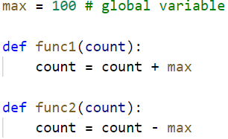
Global variable max accessed.
Variable max is defined outside func1 and func2, and therefore “global” to each. Thus, it is referred to as a global variable. As a result, it is directly accessible by both functions.
The use of global variables is generally considered to be bad programming style. Although it provides a convenient way to share values among functions, all functions within the scope of a global variable can access and alter it. This may include functions that have no need to access the variable, but none-the-less may unintentionally alter it.
Another reason that the use of global variables is bad practice is related to code reuse. If a function is to be reused in another program, the function will not work properly if it is reliant on the existence of global variables that are nonexistent in the new program
4CS001 - Introductory Programming and Problem Solving

Slide 25
Variable Lifetime
The period of time that a variable exists is called its lifetime.
Local variables are automatically created (allocated memory) when a function is called and destroyed (deallocated) when the function terminates.
Thus, the lifetime of a local variable is equal to the duration of its function’s execution. Consequently, the values of local variables are not retained from one function call to the next.
4CS001 - Introductory Programming and Problem Solving

Slide 26
Exercise – For You
Write a program to check the divisibility of a number by 7 that is passed as a parameter to the user defined function.
Write a program that implements a user defined function that accepts Principal, Time and Rate to calculate the simple interest.
Create a menu driven program using user defined functions to implement a calculator that performs the following:
Basic arithmetic operations (+, -, *, /)
Factorial of number
Mean median and mode (Import Statistics)
4CS001 - Introductory Programming and Problem Solving

Slide 27
Exercise – For You
Write a program that has a user defined function to accept 2 numbers as parameters, if number 1 is less than number 2 then numbers are swapped and returned, i.e., number 2 is returned in place of number1 and number 1 is reformed in place of number 2, otherwise the same order is returned.
Write a program that uses a user defined function that accepts name and gender (as M for Male, F for Female) and prefixes Mr/Ms on the basis of the gender.
4CS001 - Introductory Programming and Problem Solving

Slide 28
Exercise – Homework
To secure your account, whether it be an email, online bank account or any other account, it is important that we use authentication. Use your programming expertise to create a program using user defined function named login that accepts userId and password as parameters (login(uid,pwd)) that displays a message “account blocked” in case of three wrong attempts. The login is successful if the user enters user ID as "ADMIN" and password as "St0rE@1". On successful login, display a message “login successful”.
4CS001 - Introductory Programming and Problem Solving

Slide 29
4CS001 - Introductory Programming and Problem Solving

